Slide 1
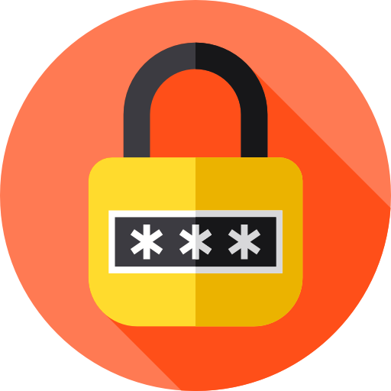
Designing Strong Passwords and Analyzing Their Security
By: Omar Sanchez, Anthony Larson and Dylan Bishop

Slide 2
Why Is A Password Generator and Password Strength Tester Important?
Unique Passwords: Encourage unique passwords for each account to reduce password reuse risks.
Enhanced Security: Prevent hackers from guessing passwords based on personal activity.
User Education: Teach users about the importance of strong passwords.
Convenience: Simplify password management for better security.(IT DOES ALL THE WORK FOR YOU)

Slide 3
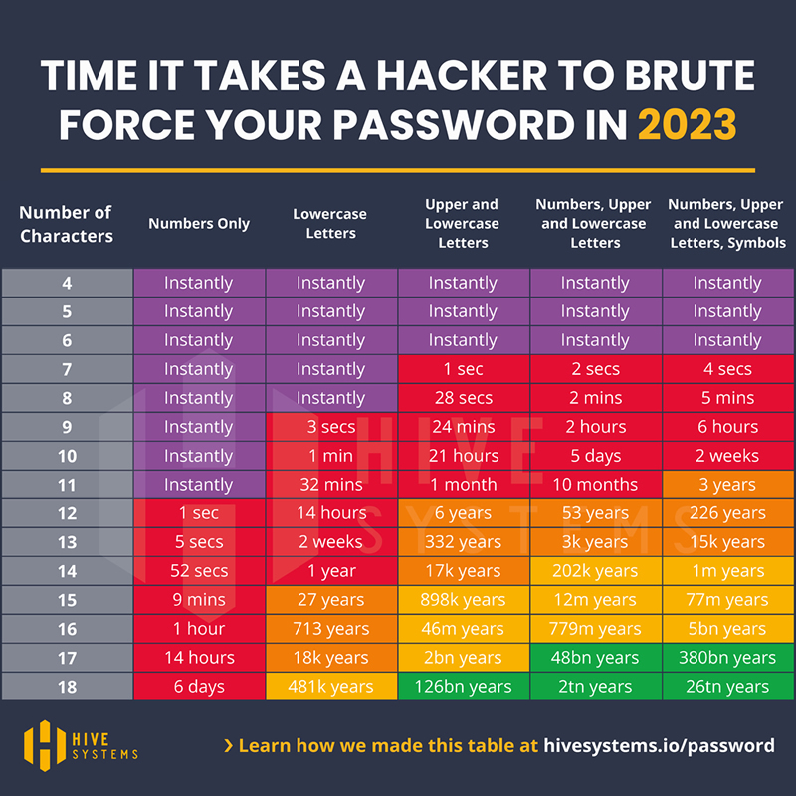
Why Is Password Security Important
Unauthorized Access Protection: Strong passwords reduce the risk of unauthorized access to accounts and sensitive information.
Brute Force Attacks: Strong passwords are harder to crack using systematic guessing.
Identity Theft Prevention: Strong passwords safeguard against identity theft and protect personal information.
Account Security: Using strong passwords across different accounts prevents a single breach from compromising multiple services.
Compliance: Strong passwords help meet regulatory and organizational security standards.
Privacy Maintenance: Strong passwords keep private conversations and sensitive information secure.
Cybersecurity Enhancement: Contributes to a broader strategy to minimize risks and vulnerabilities.
Peace of Mind

Slide 4
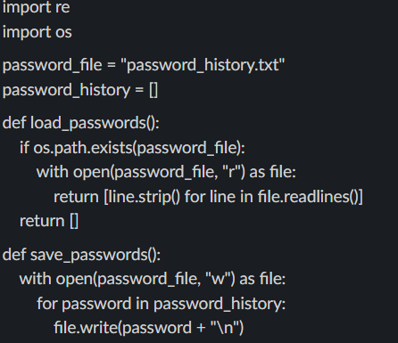
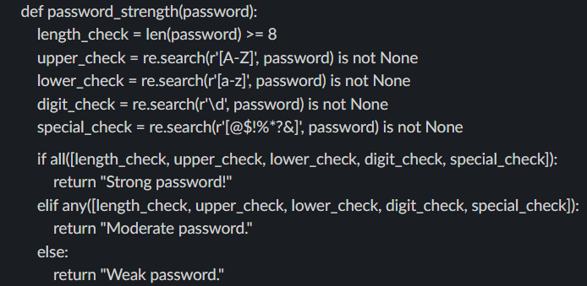
Python Coding
This Python snippet outlines the requirements for a strong password:
Minimum Length: Increased from 8>12 characters to 10>20 characters for improved security.
Special Characters: Must include at least one of the following: “!”, “$”, “@”, “?”.
Lowercase Check: Requires at least one lowercase letter.
Uppercase Check: Requires at least one uppercase letter.
We incorporated a TXT file containing the top 10,000 most common passwords to flag and prevent users from using them when creating strong passwords.

Slide 5
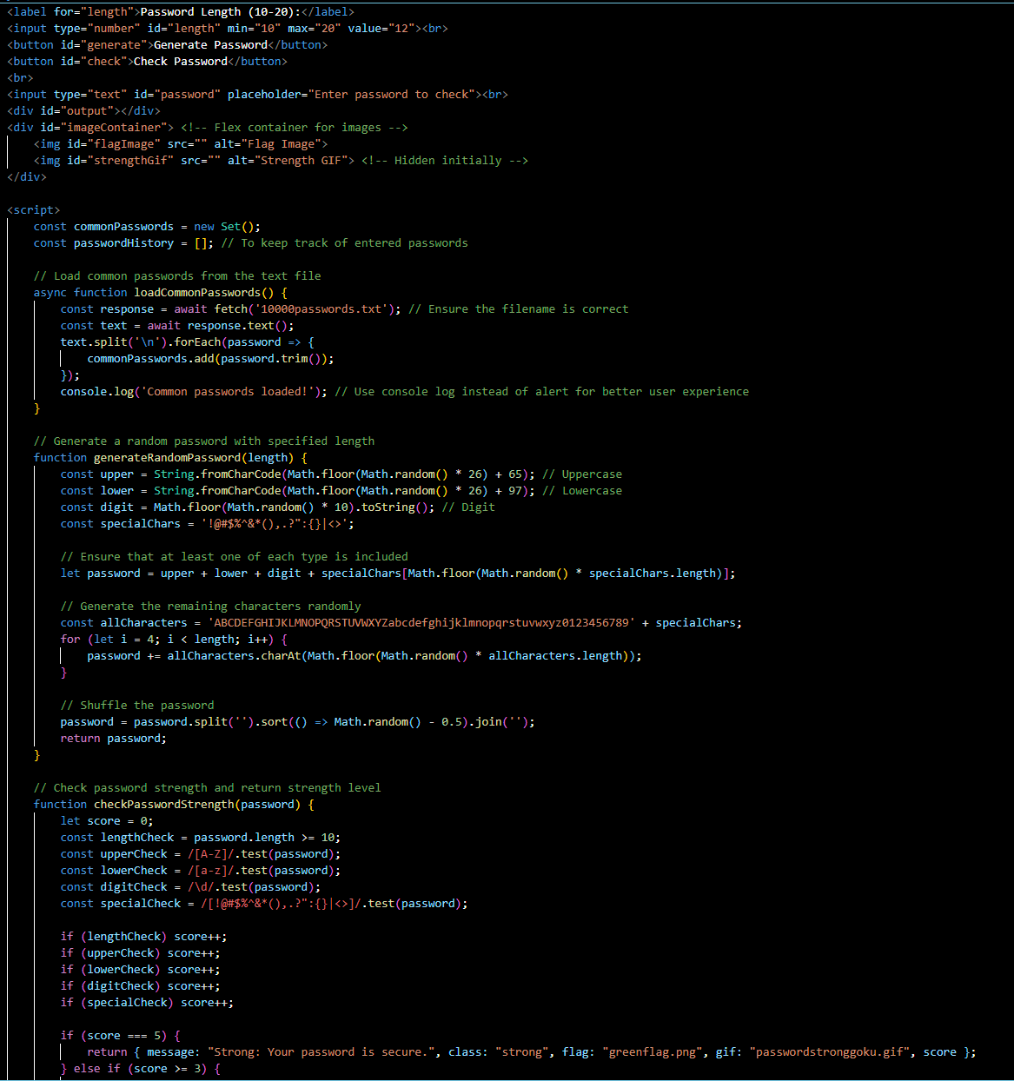



HTML Coding(Visualizing the Python code)
Breaking down the code:
loadCommonPasswords: Loads a list of common passwords from a text file (10000passwords.txt) asynchronously.
generateRandomPassword: Generates a random password of specified length with at least one uppercase letter, one lowercase letter, one digit, and special characters.
checkPasswordStrength: Assesses the strength of a password based on various criteria (length, uppercase, lowercase, digits, special characters) and returns feedback including a message, CSS class for styling, flag image, GIF for strength indication, and a score.
checkCommonPassword: Checks if a password exists in a predefined set of common passwords and returns feedback if it does.

Slide 6
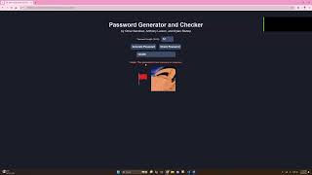
Demo

Slide 7
Demonstration Summary
Password Strength Checking: As you type in your password, the tool checks how strong it is right away. It sends the password to the server and gives you instant feedback on whether it’s strong or weak.
Interface: You’ve got a simple input field for your password and a spot to see the feedback. It makes everything straightforward.
Random Password Generation: If you want a strong password without thinking too hard. It generates a random, strong password for you. it checks how strong it is too.
Feedback: The app gives you instant, color-coded feedback to help you create better passwords.

